Slide 1
SMS
Trasnslation
SMS Messages in your language

Slide 2
Table of contents
01
02
03
04
05
Introduction
Problem
Solution
App demo
Team

Slide 3
01
Introduction

Slide 4

Our application
This android application translates all or selected SMS from inbox in demand or automatically. User can choose to translate messages to a desired language:
Custom Splash Screen (animation)
Sms messages and Inbox view with translate option.
Settings Activity to change Application Preferences.
The application usages ML models so after downloading the model user can translate sms messages offline.
SMSTrasnslation

Slide 5
02
The Problem

Slide 6
Problem
1
Imagine traveling to a country where the primary language differs from yours. You might receive SMS notifications from your bank, hotel, or local tour operator. Without understanding these messages, navigating your trip and staying informed can be difficult.
2
Business communication often involves SMS due to its speed and convenience. If you receive messages from international clients, partners, or vendors, a language barrier can hinder your ability to respond promptly and accurately.
3
For immigrants and expats adjusting to a new country, everyday communication can be overwhelming. SMS messages from local services, neighbors, or community groups might be difficult to understand

Slide 7
03
Our Solution

Slide 8
SMS Translation
Our application addresses the problem of language barriers in SMS communication. People who receive SMS messages in languages they don't understand struggle to understand the message content. Our app solves this problem by offering on-demand and automatic SMS translation. Here's how:
Translation on Demand: Users can select individual messages or translate their entire SMS inbox. This allows users to quickly understand specific messages or have their entire inbox translated for easy browsing.
Background Translation (Automatic): The app uses a service and broadcast receiver to automatically translate new messages in the background even when the app isn't open. This ensures translated messages are readily available when the user opens the SMS.
Offline Functionality: While currently internet dependent, our plan for an ML model suggests offline translation capabilities. This will further enhance user experience by eliminating the need for an internet connection.
Overall, our app bridges the language gap in SMS communication by offering convenient and efficient translation features.

Slide 9
04
Application Demo

Slide 10
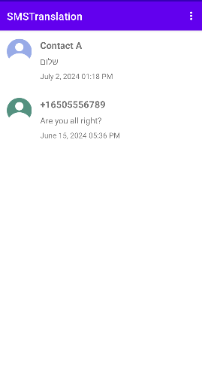

Product infographic
SMS Group
Menu
Settings menu
About Menu
Sms from or to the contact address
Users Icon
Contact Info
Name
Or number
Picture or icon saved in contacts
Last message
Last message Time and Date

Slide 11
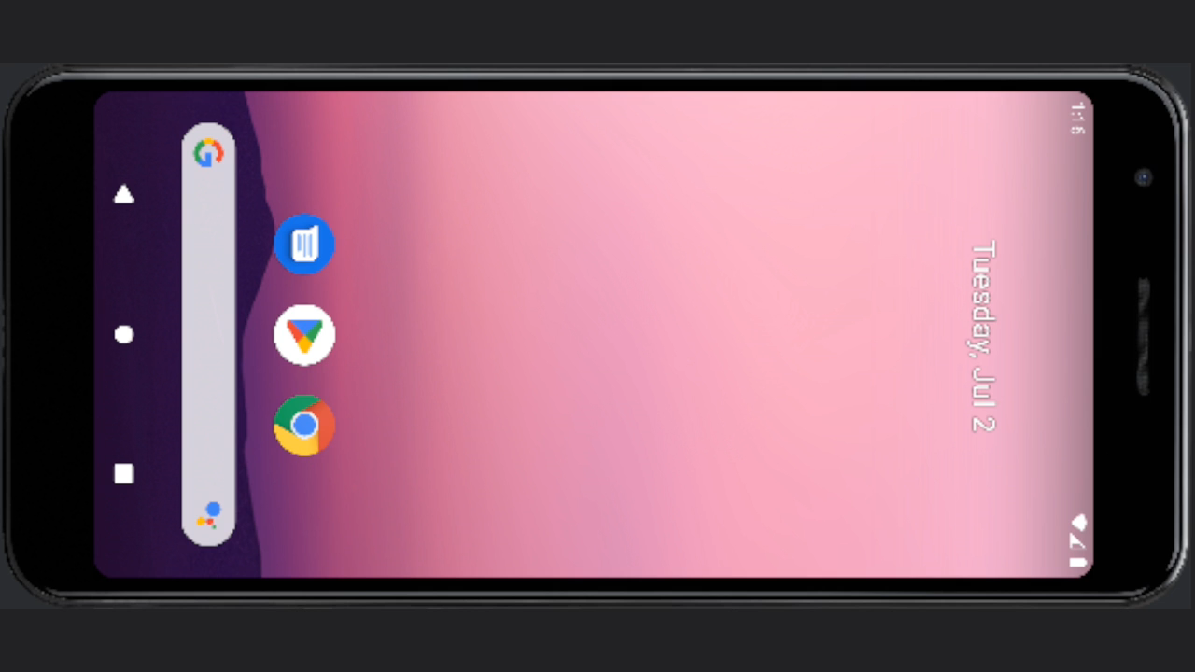

Slide 12
05
The Team

Slide 13

Niv Kalman
318163292
Eden Aovid
206120727
Avi Arges
208783209

Slide 14
Thanks!
Do you have any questions?
Feel free to ask.

